Slide 1
Blood Bank Management System
Submitted Group:
ID : 171442548 ID : 171442552 ID : 171442560
Submitted To:
Supta Richard Philip
Senior Lecturer, Department of CSE
City University, Bangladesh

Slide 2


Slide 3
Chapter: 1 - Introduction
The Blood Bank Management System is to create an e-Information about the donor and organization that are related to donating the blood. Through this application any person who is interested in donating the blood can register himself in the same way if any organization wants to register itself with this site that can also register. Moreover if any general consumer wants to make request blood online he can also take the help of this site. Admin is the main authority who can do addition, deletion, and modification if required.

Slide 4
1.1 Problem Statement
Existing System
No use of Web Services and Remote Apps.
Risk of mismanagement and of data in manual system.
Less Security.
No proper coordination between different Applications and Users.
Fewer Users – Friendly

Slide 5
1.2 Proposed Solution
The people in need of blood can search for the donors by giving their blood group and city name.
It is very flexible and user friendly.
The person’s time and work is reduced very much which prevails in the present system.
Easy and Helpful.
The people are not limited to receive or provide services in working hours of the branch only; he is serviced 24 hours a day, 7 days of week and 365 days of the year.

Slide 6
Chapter: 2 - Related Projects
2.1 Related Project 1: Hospital Management System
A Hospital Management System is an integrated information system for managing all aspects of a hospital's operations such as medical, financial, administrative, legal, and compliance. It includes electronic health records, business intelligence and revenue cycle management.
2.2 Related Project 2: Medical Store Management System Drug Store Management and Rational Drug. Drugs & Medicines being expensive and resources limited, it becomes imperative to improve their supply, increase the use, and minimize the cost through a pharmaceutical management system to be effectively put in place.

Slide 7
Chapter: 3 - System Analysis
First in the system development process is preliminary Investigation. Preliminary Investigation is conducted in the following phases.
Project clarification
Feasibility study
Project appraisal

Slide 8
3.1.0 Feasibility Study
The feasibility study is performed to determine whether the proposed system is viable considering the Technical, Operational and Economical factors. After going through feasibility study we can have a clear-cut view of the system’s benefits and drawbacks.
Technical feasibility
Economic feasibility
Operational feasibility

Slide 9
3.2.1 Functional Requirements
In this system there will be four types of Users
Admin
Blood Bank
Blood Donor
Patient
There will have some functions like Add Blood Donor Information, Edit Blood Donor Information, Add Blood Bank, Blood storage, Adjustment and Reporting. Every function has one or more sub-functions.
Sub-functions of Add Admin Information are
Add Blood Bank
Add Blood Category
Add Donor
Add Blood Supplier
Sub-functions of Blood Bank are
Add Blood Donor
Branch Information
Add Branch
Add Blood Supplier
Add Storage
Sub-functions of Blood Donor are
Blood Report
Personal Information
Sub-functions of Patient are
Request Blood
Personal Information
Every user has different access
Admin can access everywhere
Blood bank can access Donor and Patient Information

Slide 10
3.2.2 Non-Functional Requirements
Check database connection
Insure Blood Information conflict
Check availability of blood in storage
Check previous donation date of donor
Authenticate user

Slide 11
3.3 Observation
The data is also collected by observation of the firm. The data is collected by observing on the site at different timings and at different situations like when the firm is busy and when the firm hasn’t much work to do.

Slide 12
3.4 Questioners
The data is collected through questioners by filling a set of questions from the different levels of management. The questions made by questioners are three different types.
They are,
Structured questioners:
Unstructured questioners:
Semi-structured questioners:

Slide 13
3.5 Interviews
Interviews were conducted to collect the information. The interviews were conducted at two levels.
Formal Group Interviews: the interviews conducted for formal groups i.e., the hierarchical (official) groups in the firm.
Informal Group Interviews: the interviews were conducted for informal groups i.e., the groups formed outside the company.

Slide 14
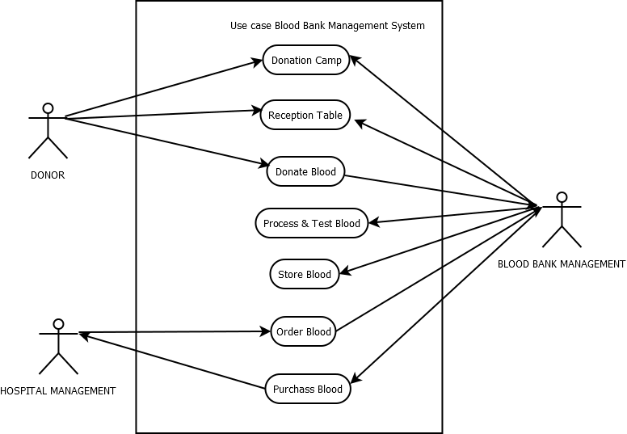
Chapter: 4 – Design 4.1 Use Case Diagram

Slide 15
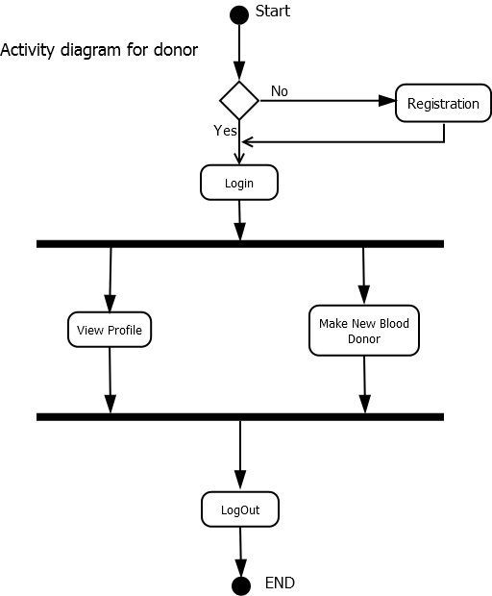
4.2 Activity Diagram

Slide 16
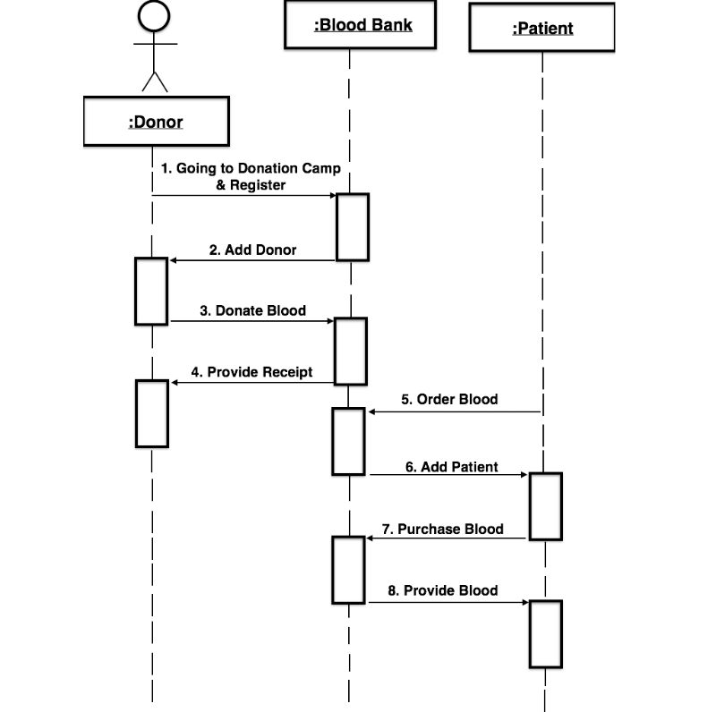
4.3 Sequence Diagram

Slide 17
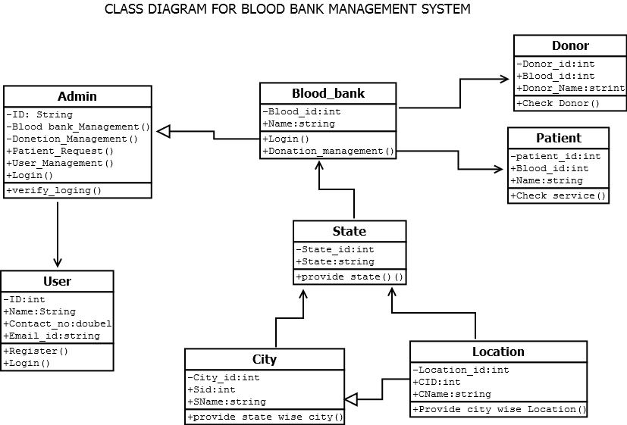
4.4 Class Diagram

Slide 18
Chapter: 5 - Implementation Evaluation
During the software-testing phase each module of software is thoroughly tested for bugs and for accuracy of output. The system developed is very user-friendly and the detailed documentation is also given to the user as online help wherever necessary. The implementation phase normally ends with the formal test involving all the components.
The entire system was developed using the PHP, HTML, JavaScript, Personal Web Server, and MySql as back end. The HTML is used to design the web page. The Personal Web Server is used to understand the client’s request and to send response to them. The JavaScript, are used for client-side validations so that the user can enter only appropriate input in the input fields. The MySql is the back end tool where the database resides.
Hence the design of the entire system is user-friendly and simple the implementation has been quite easy.

Slide 19
Chapter: 6 - Conclusion
This project has given us an ample opportunity to design, code, test and implements an application. This has helped in putting into practice of various Software Engineering principles and Database Management concepts like maintaining integrity and consistency of data. Further, this has helped me to learn more about MySql, PHP, HTML, JavaScript, Adobe Photoshop 7.0 and Personal Web Server.
I thank my guide for his invaluable contribution in guiding me throughout the project. I also thank my teacher and friends who have supported and motivated me to complete this project successfully.

